Slide 1
EMBEDDED SYSTEM DESIGN PROJECT ESE-4009 Interfacing Cloud with beaglebone black using ESP32
Submitted by: HARMANDEEP SINGH (C0751299)
(Group 2)

Slide 2
List Of content
Project Introduction
Task Introduction
Tool Requirements
Hardware Setup
Description of connections
Software part
Results
conclusion
References

Slide 3
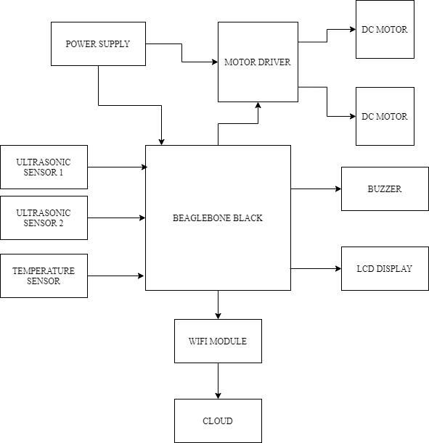
IoT based Visitor Counter using Beaglebone Black

Slide 4
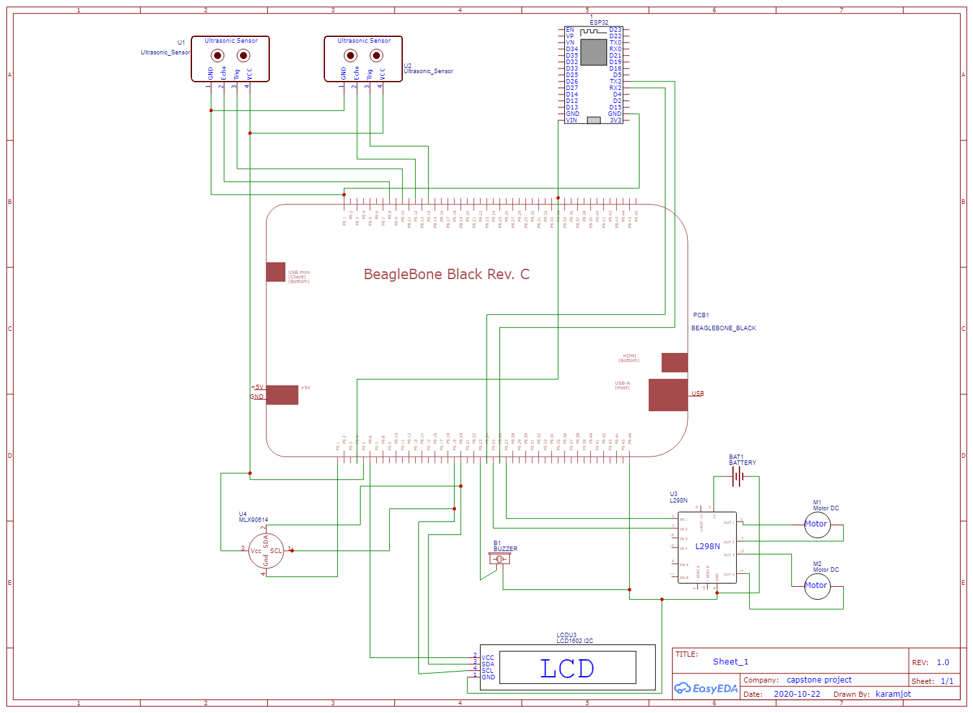
Schematic Diagram of the Project

Slide 5
Task Introduction
This task is about interfacing the cloud service with Beaglebone black.
The cloud service used in this project is ThingSpeak.
Here, ESP32 is used to accomplish this task.
Beaglebone black is connected with ESP32 and ESP32 is connected with ThingSpeak.
The upcoming slides will explain about the connections and all the hardware and software used to accomplish this task.

Slide 6
Tools Required for Interfacing
HARDWARE
Beaglebone Black
ESP32
USB Cable
Breadboard
Connecting Wires
SOFTWARE
PUTTY
Eclipse IDE
Arduino IDE for ESP32
WINSCP
Debian OS (Installed on BeagleBone Black)
Nano Editor
GCC compiler to run the code
ThingSpeak access

Slide 7
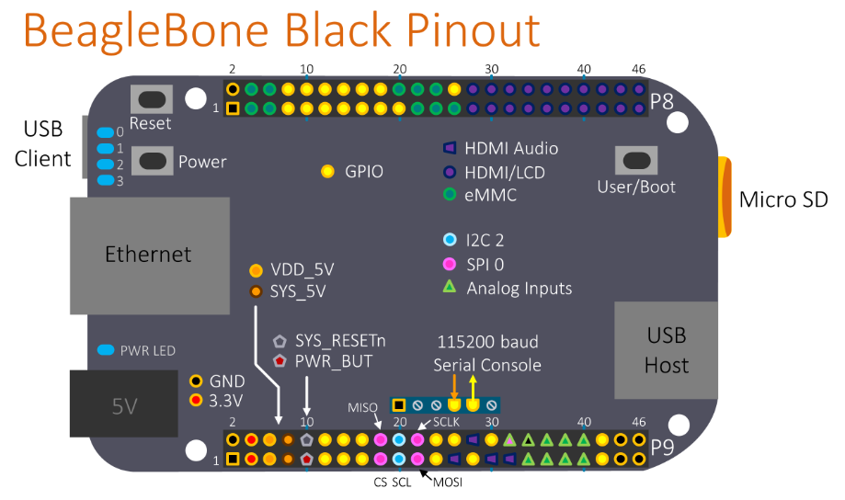
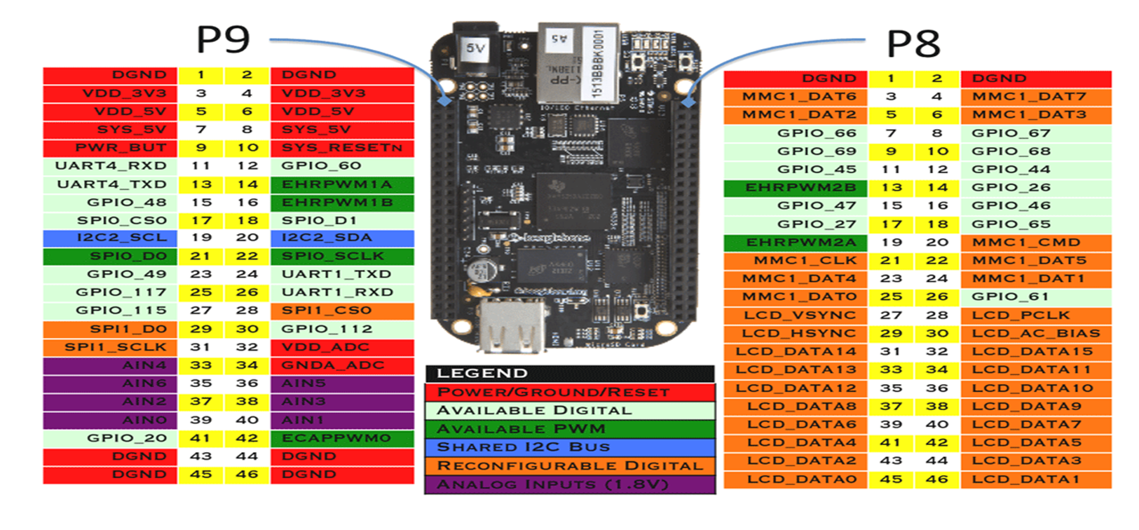
Beaglebone black pinout

Slide 8
esp32
ESP32 is a series of low-cost, low-power system on a chip microcontrollers with integrated Wi-Fi and dual-mode Bluetooth.
ESP32 series employs a Tensilica Xtensa LX6 microprocessor in both dual-core and single-core variations and includes built-in antenna switches, RF , power amplifier, low-noise receive amplifier, filters, and power-management modules.
It is created and developed by Espressif Systems, a Shanghai-based Chinese company.
Since Arduino IDE has officially released board managers for ESP32 it has become very easy to program these devices.

Slide 9
Use of esp32 in the project
In our project we need to send the total count of people inside the store to the cloud, so we need wireless connectivity.
As Beaglebone Black does not have inbuilt Wi-Fi module, so external Wi-Fi module ESP32 is used as a Wi-Fi module for IoT connectivity.
For establishing communication between two boards we are using UART protocol.
ESP32 supports wireless IEEE 802.11 standard.

Slide 10

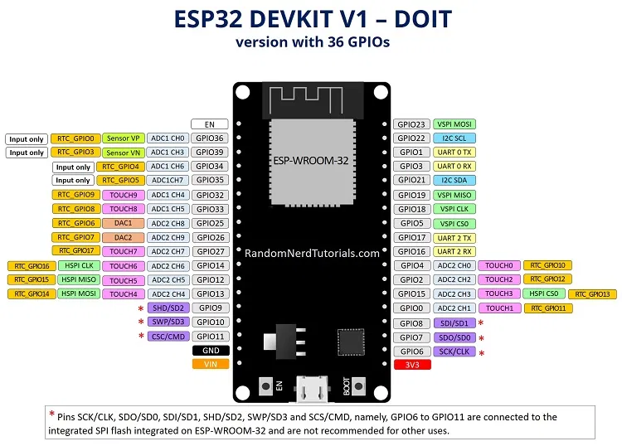
Pin description of esp32
The operating voltage is 3.3V
It can be powered through the micro usb cable.
We have used UART TX0 and RX0 to communicate with the beaglebone black.

Slide 11
Uart interfacing between beaglebone black and esp32
The Beagle Bone Black has five available on-board serial UART ports.
These ports are named as BB-UART1, BB-UART2, BB-UART4, BB-UART5.
We have used BB-UART1 for interfacing with ESP32 serially.
 | RX | TX | Device | Remarks
UART0 | J1_4 | J1_5 | /dev/ttyO0 | Beaglebone black only
UART1 | P9_26 | P9_24 | /dev/ttyO1
UART2 | P9_22 | P9_21 | /dev/ttyO2
UART3 |  | P9_42 | /dev/ttyO3 | TX only
UART4 | P9_11 | P9_13 | /dev/ttyO4
UART5 | P8_38 | P8_37 | /dev/ttyO5

Slide 12
Enabling Uart pins
The BBB by default has the UART pins set as normal GPIO pins so they need to be changed to UART pins first before they will work.
The following steps were followed to enable the UART1 pins:
Change to root user by using command “ sudo su ”
Create /usr/local/sbin/setTty.sh which is the script that will configure the UART serial port on the Beaglebone Black
nano /usr/local/sbin/setTty.sh

Slide 13
Continued
Then type this into the file :
#!/bin/sh
config-pin p9.26 uart
config-pin p9.24 uart
stty -F /dev/ttyO1 sane
Make the file executable for all users and writable for root user by this command : chmod 755 /usr/local/sbin/testTty.sh
Create the service configuration file that makes the system run it on startup using this command : nano /lib/systemd/system/setTty.service

Slide 14
Now type this into the file :
[Unit]
Description=Configure pins to enable ttyS1 as a UART
After=syslog.target network.target
[Service]
Type=simple
ExecStart=/usr/local/sbin/setTty.sh
[Install]
WantedBy=multi-user.target

Slide 15
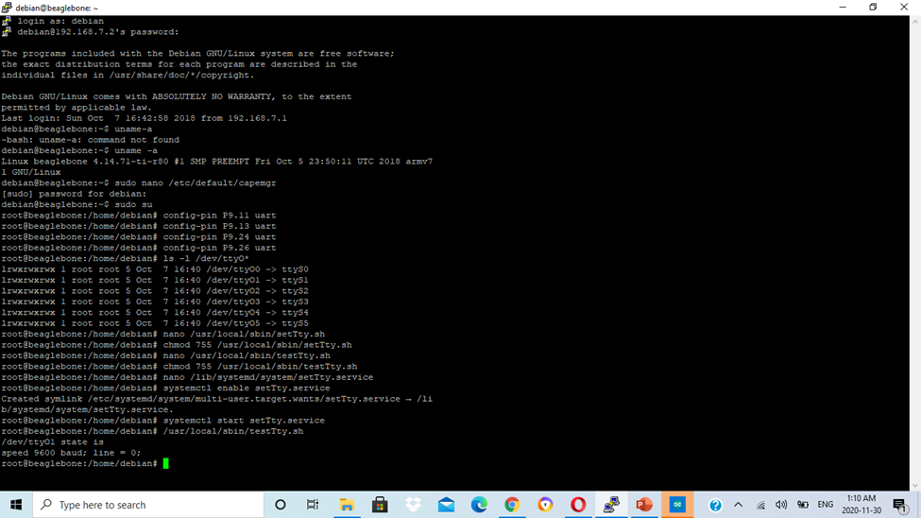
Enable the service to run on startup
Then start the service and test
Success results in the following output:
/dev/ttyO1 state is
speed 9600 baud; line = 0;

Slide 16
Pin connections
On port 9 of BBB, pin 24 and pin 26 are designated to UART1.
The TX0 pin of ESP32 is connected to P9_26 (UART1_RXD).
The RX0 pin of ESP32 is connected to P9_24 (UART1_TXD).
The GND pin of ESP32 is connected to P8.1(GND) pin of BBB.
The ESP32 is powered through micro-USB cable.

Slide 17
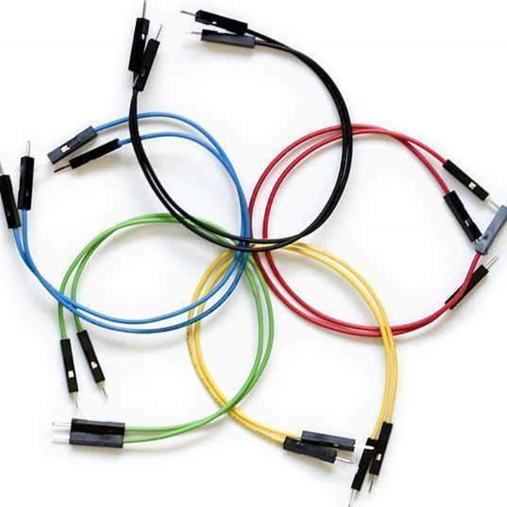
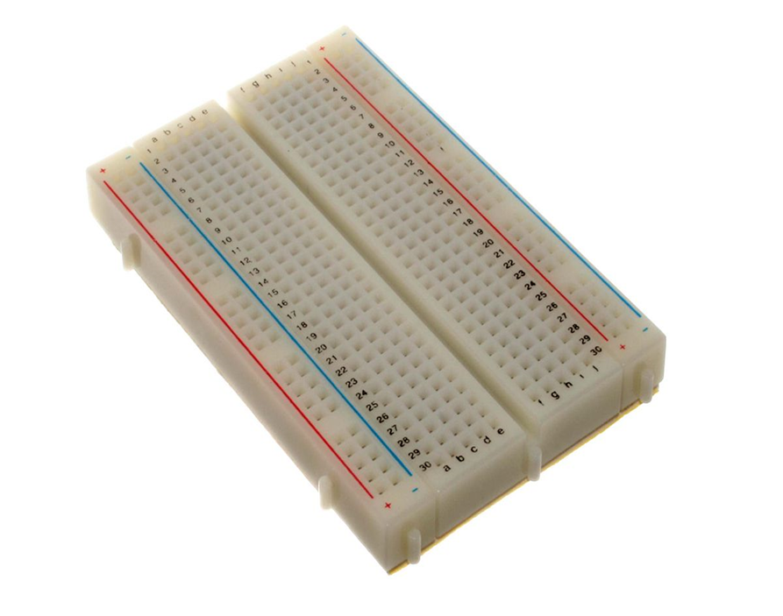
Jumper wires and breadboard
Breadboard and jumper wires are used to make connections between ESP32 and beaglebone black.

Slide 18

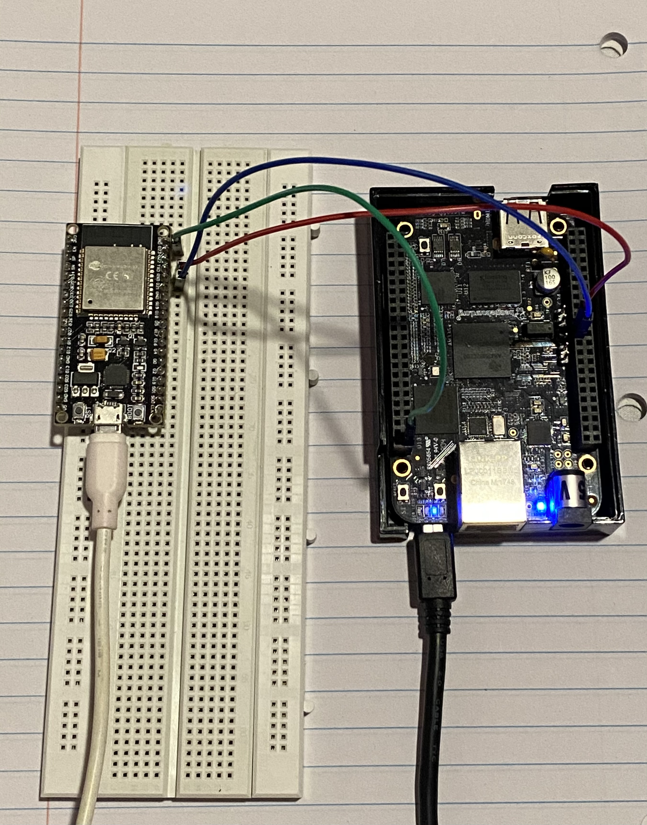
Hardware connections

Slide 19
Cloud service
Since the user community of BeagleBone Black is getting strong day by day so we have large amount of contributions made each day. Thus it is common to see that most often the user community uses ThingSpeak as their common interface to connect to the cloud service.
Though some prefer other cloud services like AWS(Amazon Web Services), Microsoft Azure, Google Drive, Adafruit cloud etc.
So Lets discuss first what is thingspeak and how it works.

Slide 20
Thingspeak
ThingSpeak is an IoT analytics platform service that allows you to aggregate, visualize, and analyze live data streams in the cloud.
It provides instant visualization of data posted by our devices on cloud.
It uses the HTTP and MQTT protocol to store and retrieve data over the Internet or via a Local Area Network.
ThingSpeak is related with Mathworks Inc. so we just need our mathworks account credentials to login into ThingSpeak.

Slide 21
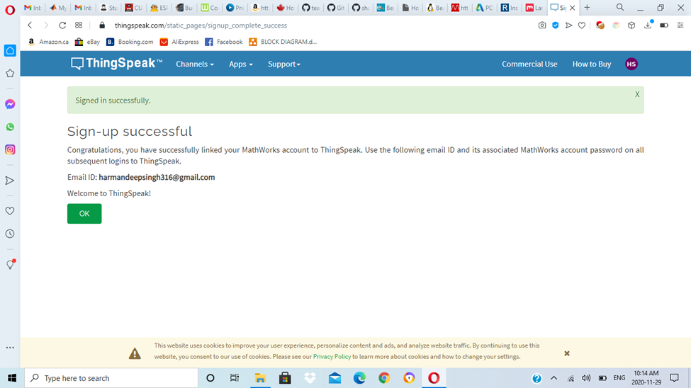
Getting started with thingspeak
Go to https://thingspeak.com/
Click on Get started for free
Enter your existing mathworks account email and password or create a new one.
After successful login you will get this page.

Slide 22
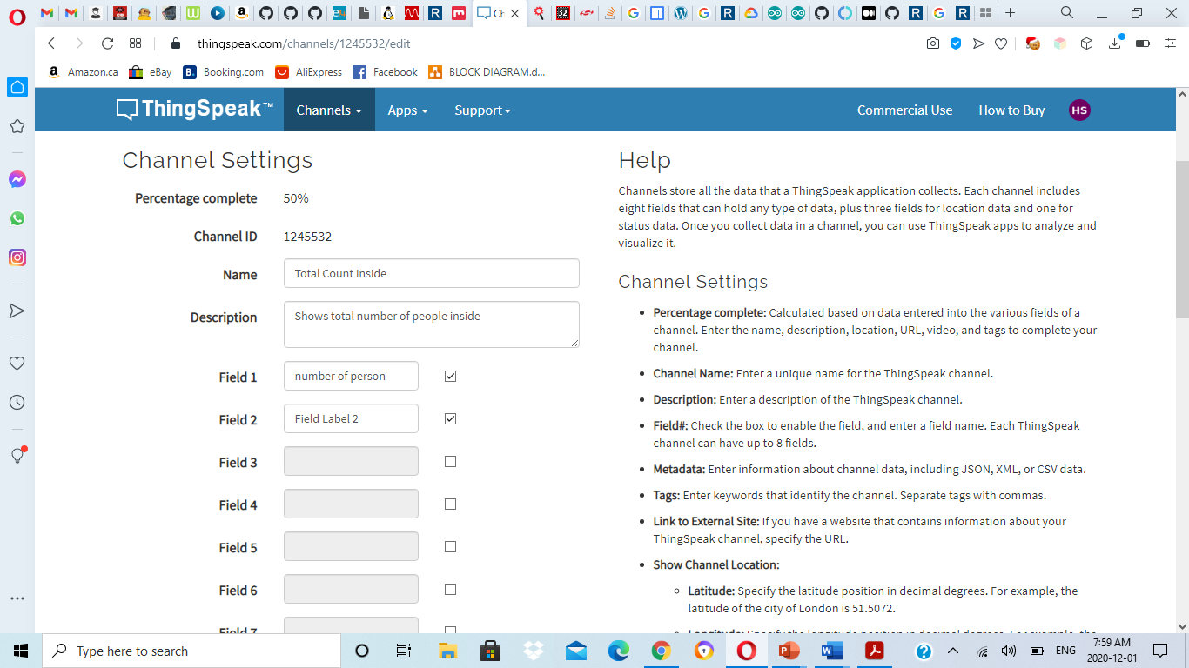
Creating a new channel
After login Click on new channel and create a channel and we can set the name , Description, fields as per our requirements.
Each channel is identified by a unique channel ID
Help section is also there at the right side for assisting us.

Slide 23
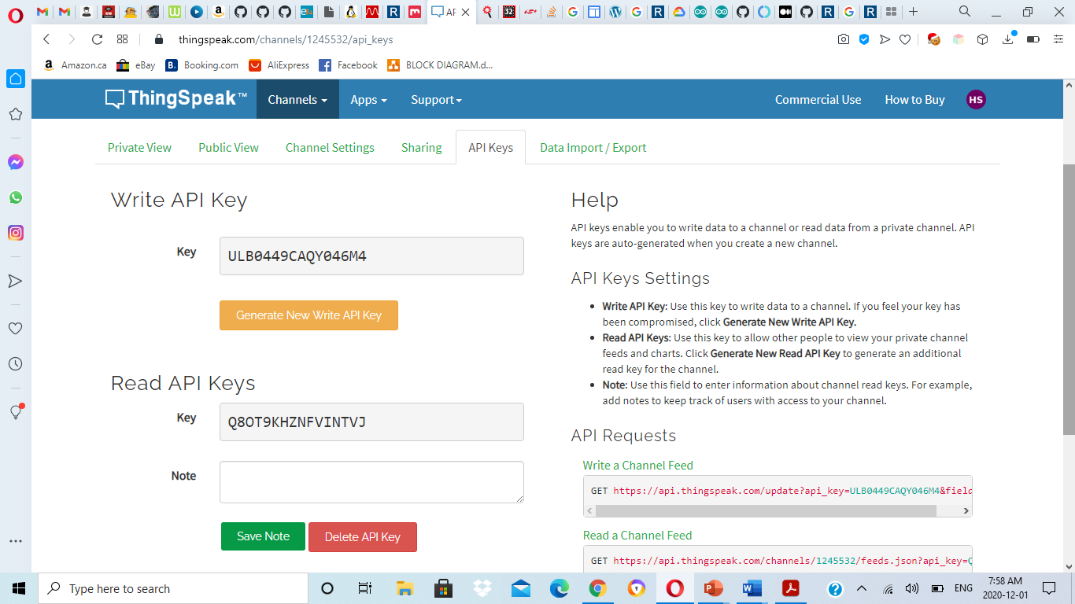
API KEY
Whenever we write or read data from or to Thingspeak we need to use the API keys found in our account.
We have to copy the API keys to our program
There is an option for regenerate new API key if old one is misplaced. For both write and read API keys there are option to regenerate keys

Slide 24
Protocols used
For the cloud connection we use the WiFi communication (IEEE802.11).
IEEE 802.11 is part of the IEEE 802 set of local area network (LAN) protocols, and specifies the set of media access control (MAC) and physical layer (PHY) protocols for implementing wireless local area network (WLAN) Wi-Fi computer communication in various frequencies, including but not limited to 2.4 GHz, 5 GHz, 6 GHz, and 60 GHz frequency bands.
To establish the connection we use the HTTP.
The Hypertext Transfer Protocol (HTTP) is an application layer protocol for distributed, collaborative, hypermedia information systems.
HTTP is the foundation of data communication for the World Wide Web, where hypertext documents include hyperlinks to other resources that the user can easily access, for example by a mouse click or by tapping the screen in a web browser.

Slide 25
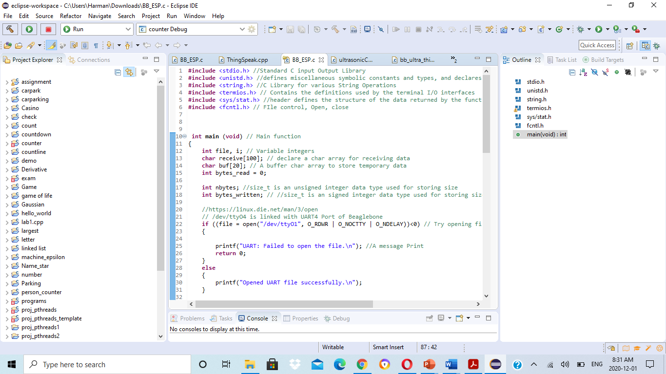
Eclipse ide
Eclipse IDE is used to write the code for Beaglebone black.
The programming is done in C language.

Slide 26

Beaglebone black code overview

Slide 27
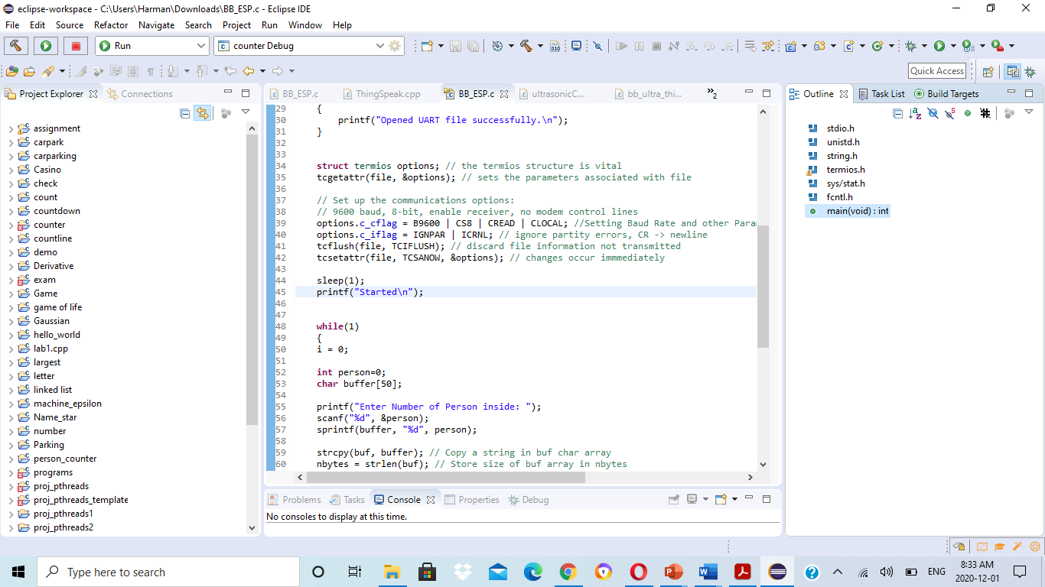
continued

Slide 28
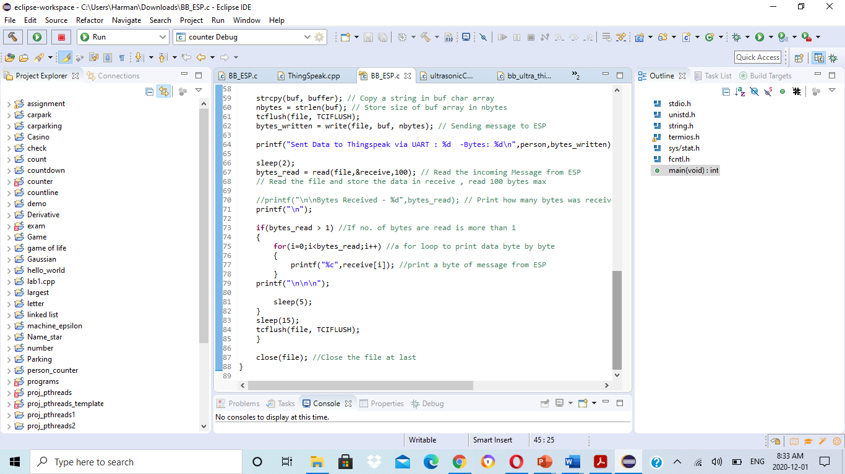
continued

Slide 29
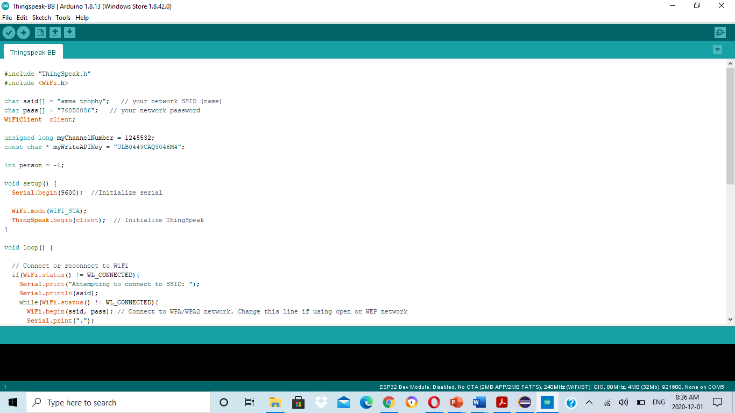
Esp Code in Arduino ide

Slide 30
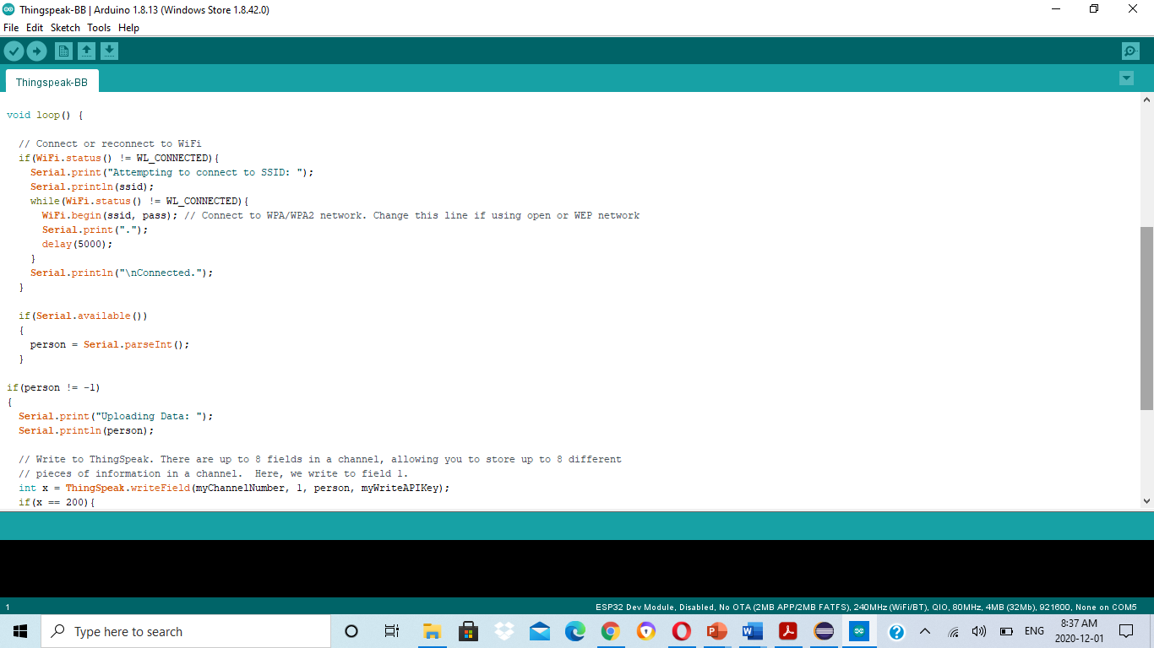
Cont.

Slide 31
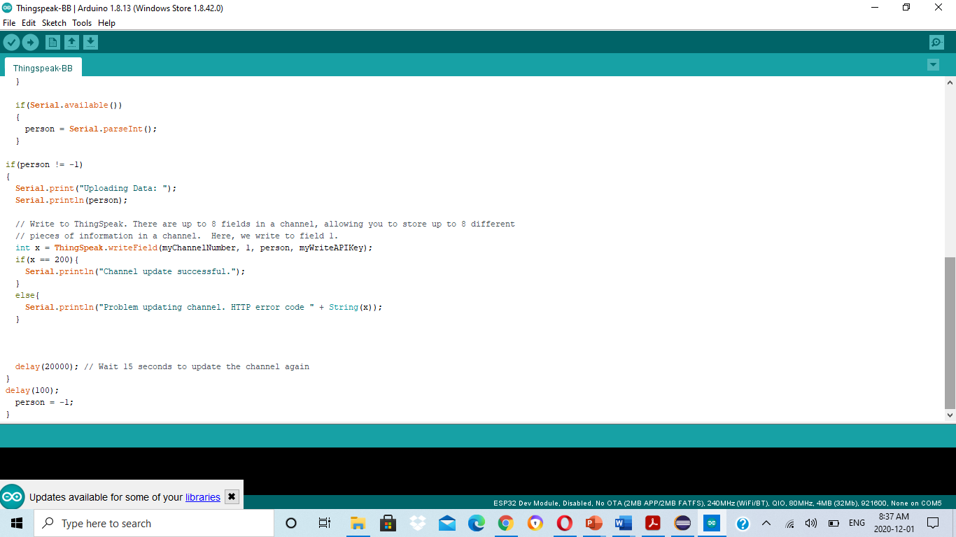
Cont.

Slide 32
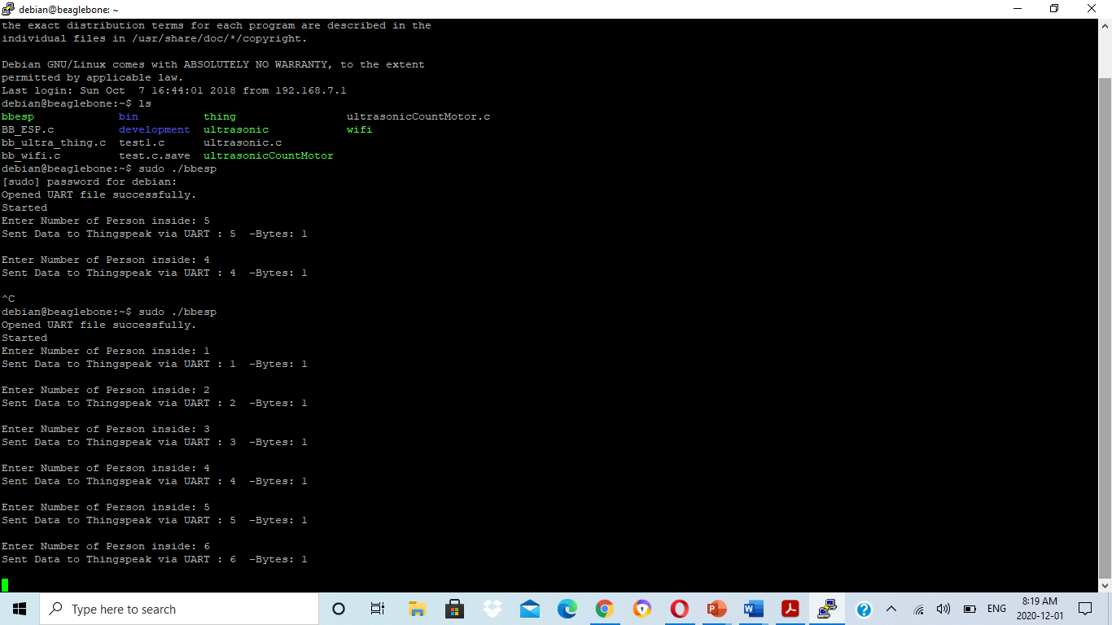
Output in putty

Slide 33
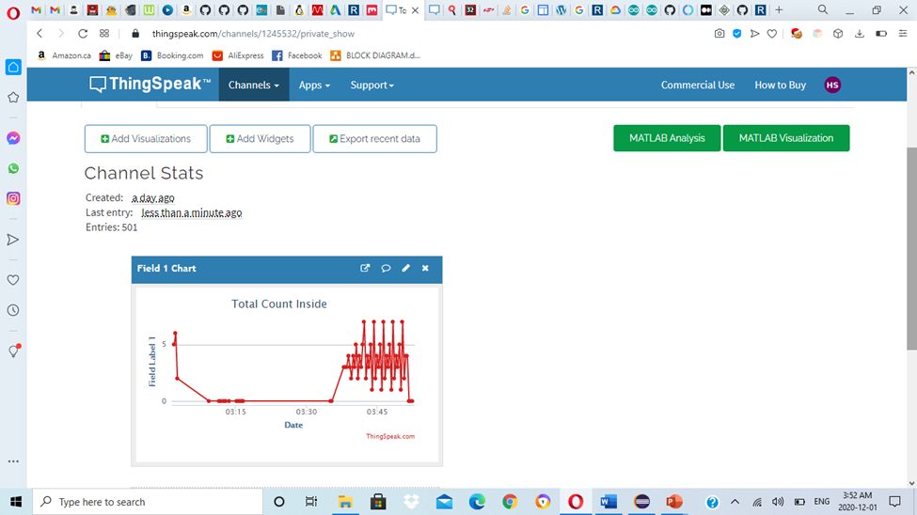
Output at cloud

Slide 34
Reference
Xantium-enterprises(2015,sept 4).Serial port programming on linux. Retrieved from https://github.com/xanthium-enterprises/Serial-Port-Programming-on-Linux/blob/master/USB2SERIAL_Read/Reciever%20(PC%20Side)/SerialPort_read.c
Robo india (n.d.).NodeMCU data upload on Thingspeak on Arduino IDE. Retrieved from https://roboindia.com/tutorials/nodemcu-dht11-thingspeak-data-upload/
Trevor's electronic blog.(n.d). How to get UART serial port working on beaglebone black. Retrieved from https://electronics.trev.id.au/2018/02/09/get-uart-serial-ports-working-beaglebone-black
ESP32 – DevKitC, Retrieved from: / https://components101.com/microcontrollers/esp32-devkitc

Slide 35
Thank you

